Slide 1
Anomalies in Traffic Data of Strategic/Major Roads
Nahush Kolhe
Supervised by Prof. Edward Chung
The Hong Kong Polytechnic University
30th May 2024

Slide 2
Introduction
Using the flow, speed and occupation data of detectors on strategic/major roads, we have tried to find anomalies in the data.
We also have used the location of detectors to analyse the correlation between nearby detectors on the same road and in same direction.
We found 3 kinds of Anomalies:
Trees Blocking the view : Due to trees blocking the detector view, it records trash values leading to bad correlation with nearby detectors.
Diverging roads’ flow anomaly : The upstream road diverges into two downstream roads. We expect the total flow of upstream road to be greater than one of the downstream road, but during an anomaly we find it to be lesser.
Abnormal values for certain time period : We see abnormally high/low values for a certain period of time. Also we found anomaly during the same time for far away detectors.

Slide 3
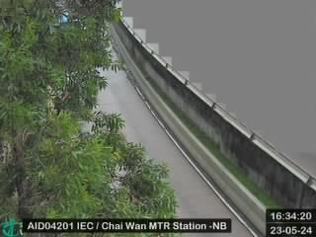
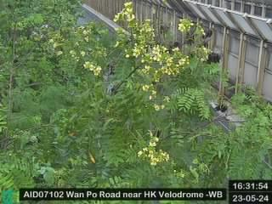

1) Trees Blocking the view
AID04201
AID07102
AID08203
These detectors are recording trash values due to obstructed view.

Slide 4
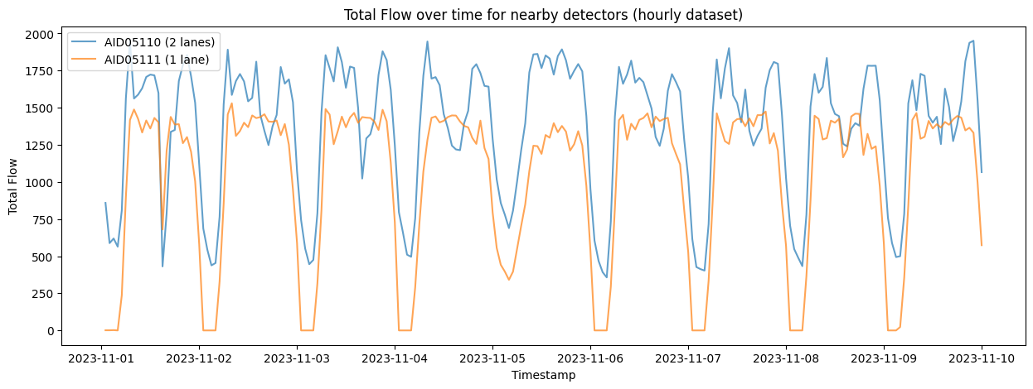
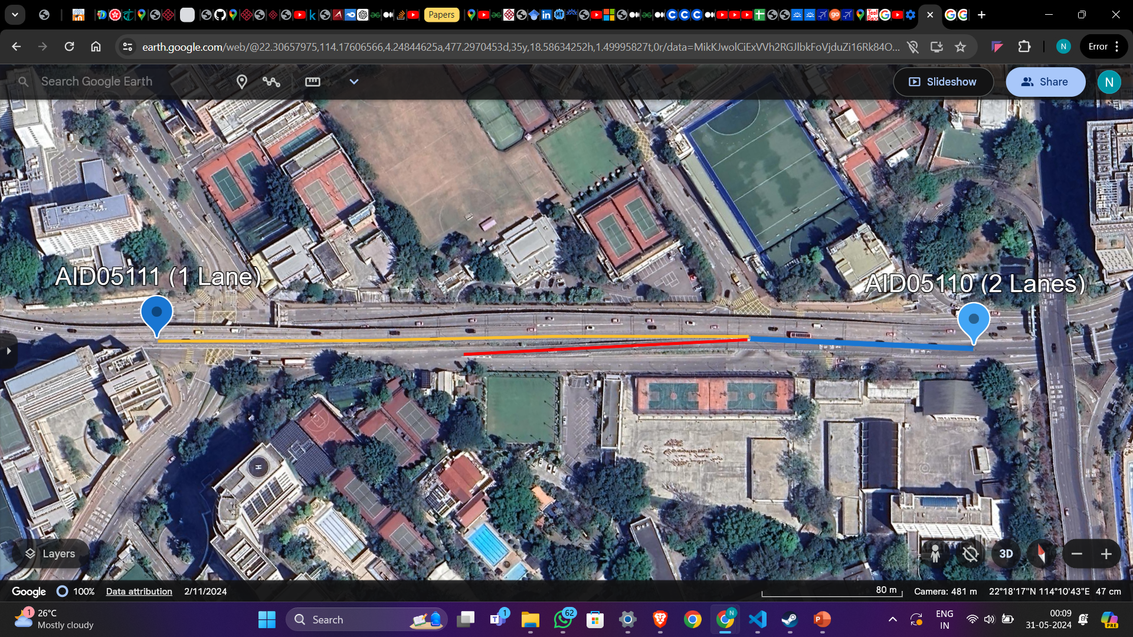
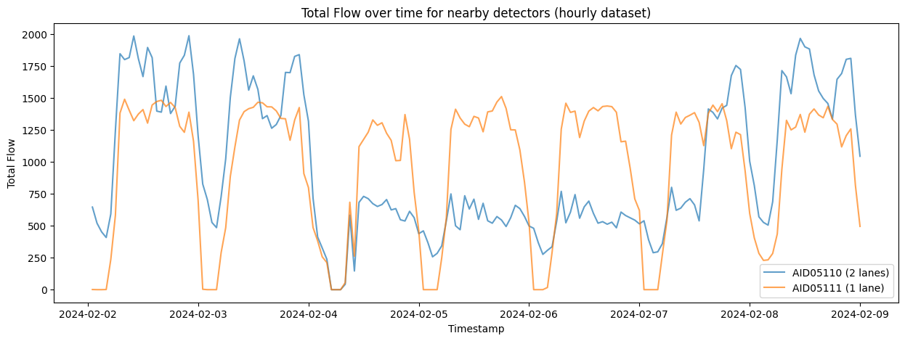
2) Diverging roads’ flow anomaly
Anomalies
1)
AID05110 (westbound, 2 lanes) : Upstream detector of blue road. AID05111 (westbound, 1 lane) : Downstream detector of yellow road.
The blue road diverges into yellow and red road. We expect the total flow of blue to be greater than yellow at all times, but in
1st image we can see for certain periodic period of time the yellow flow exceeding the blue one.
Further in 2nd image for a specific time period the yellow flow is exceeding the blue for about 3 days. ( Anomaly in blue data. )
2)

Slide 5
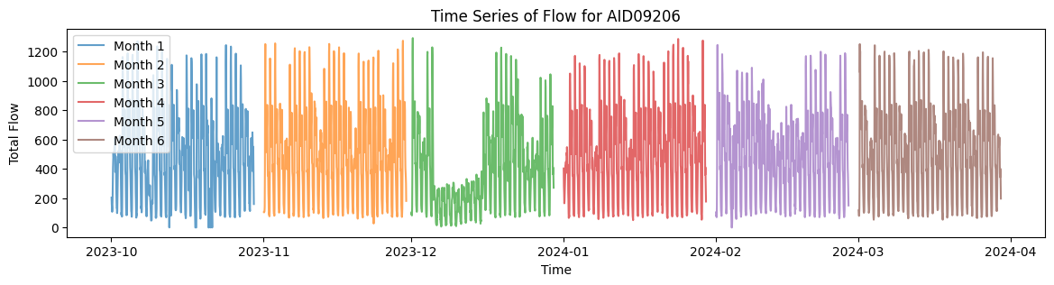
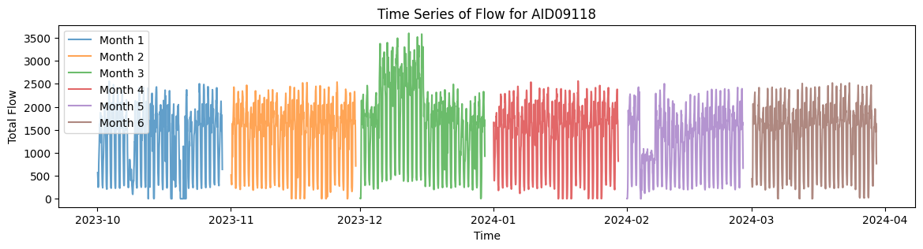
3) Abnormal values for certain period
In the timeseries plot, clearly the flow value of AID09206 is abnormally low and for AID09118 it is abnormally high for the same time period in early Dec 2023.
Even though these detectors are far away from each other we see the anomaly during same time period

Slide 6
Thank You

